Slide 1
Covid-19 Detection with X-ray Images and Transfer Learning Techniques
Presented by: Andleeb Chaudhri
Bansari Patel
Divya Karthikeyan
Austin Witter

Slide 2
INTRODUCTION
Deep learning techniques have made major breakthroughs in the past decade.
The task of image classification finds its way in our day to day lives with x-ray images to label illnesses such as cancer, classifying hand-written digits and face recognition.
Machine learning techniques are widely accepted as a prominent tool to improve the prediction and diagnosis of many illnesses such as cancer. In this study, a dataset of X-ray images from patients with common bacterial pneumonia, confirmed Covid-19 disease, and normal incidents is utilized for the automatic detection of the Coronavirus disease.
In our paper, we will be focusing on the Image Classification aspect of Computer Vision.
Furthermore it discusses predicting images and labeling images as Covid-19 positive, Pneumonia positive or Normal, being negative for both cases.
The models used for this specific purpose are VGG16, VGG19 and ResNet101.

Slide 3
Transfer Learning Techniques
Transfer Learning in Machine Learning involves storing knowledge gained while solving one problem and applying it to a different but related problem.
According to Apostolopoulos et. al, with Transfer Learning, the detection of various abnormalities in small medical image datasets is an achievable target, often yielding remarkable results.
Transfer learning allows us to use knowledge gained in one task in completing another related task.
The models used for our study are VGG16, VGG19 and ResNet101.
For the purpose of this project, our transfer learning comes in the form of computer vision models tested on ImageNet datasets.
Transfer Learning in Computer Vision allows us to take the last layers away from a predefined model integrating both the pre-trained model (trained on thousands on images) and our own image data as the last layers.

Slide 4
VGG16
VGG-16 is a convolutional neural network model.
With a percent of 92.7% this model achieves the top 5 test accuracy in ImageNet.
The 16 in Vgg-16 refers to the 16 layers that have some weights.
VGG19
VGG-19 is also a convolutional neural network model, its architecture is essentially the same as VGG-19, difference being that VGG-19 contains 19 convolutional layers instead of 16 making it a larger system.

Slide 5
ResNet101
The makers of ResNet101 emphasized that deeper neural networks are more difficult to train and presented a residual learning framework to ease the training of networks that are substantially deeper.
ResNet offers reformulated layers as learning residual functions with reference to layer inputs, instead of learning unreferenced functions.
ResNet frameworks are easier to optimize and gain accuracy from considerably increased depth.

Slide 6
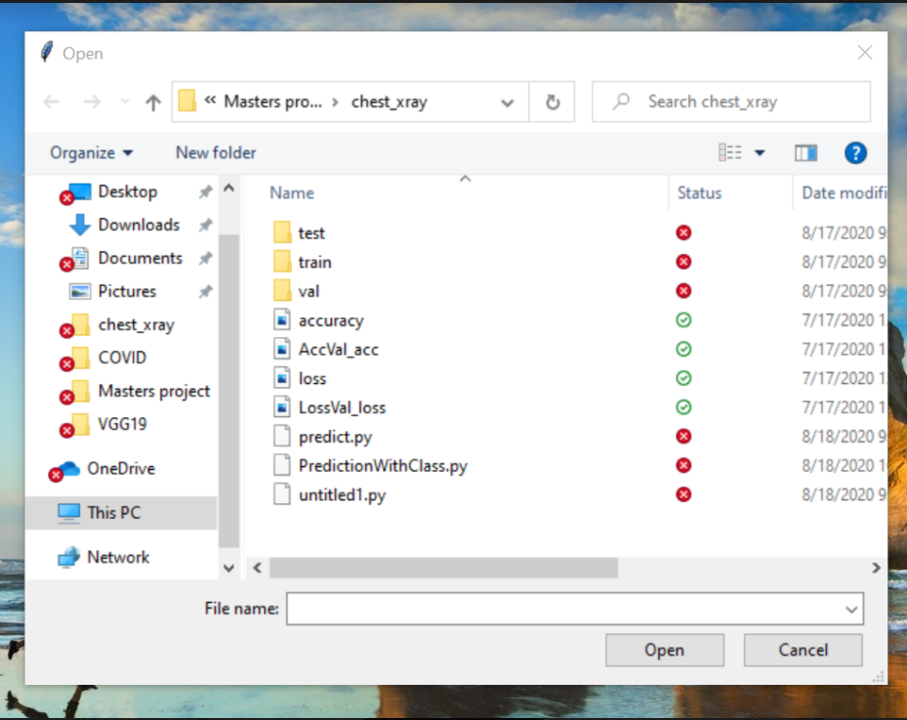
Model Generation
To create the models, the data was split in the following way. 80% for training, 10% for validation and 10% for testing.
After generating the models, we used test data in the form of a chest X-ray image to make predictions. For this step, we created an application which upon running will prompt us to the screen in Figure 1 below and allow us to select an image to label.

Slide 7
RESULTS
The models VGG16 and VGG19 were developed and tested for accuracy for a maximum for 5 epochs. ResNet101 was tested with a total of 10 epochs.
The table in Figure below displays the results of each model over 1 to 5 epochs. All models performed well when all models were compared at 5 epochs, ResNet101 had the best accuracy rate at 0.9746%. This was followed by VGG16 at 0.9647% and then VGG19 at 0.9532%.
Model | 1 | 2 | 3 | 4 | 5
VGG16 | 0.9155 | 0.9561 | 0.9530 | 0.9633 | 0.9647
VGG19 | 0.8999 | 0.9398 | 0.9541 | 0.9525 | 0.9532
ResNet101 | 0.9183 | 0.9539 | 0.9582 | 0.9661 | 0.9746

Slide 8
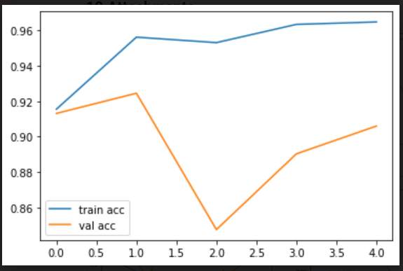
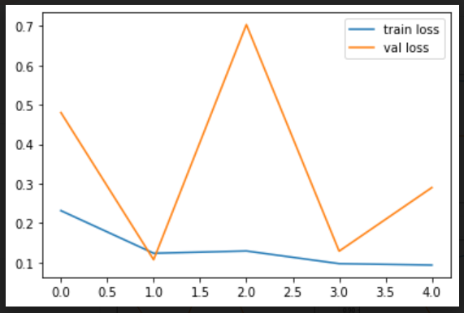
VGG16 Accuracy and Loss

Slide 9
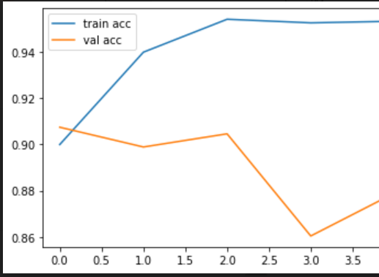
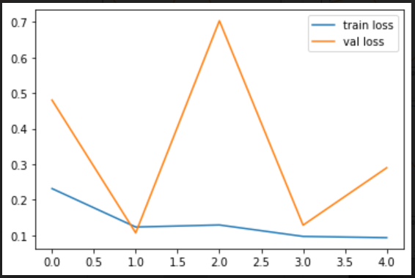
VGG19 Accuracy and Loss

Slide 10
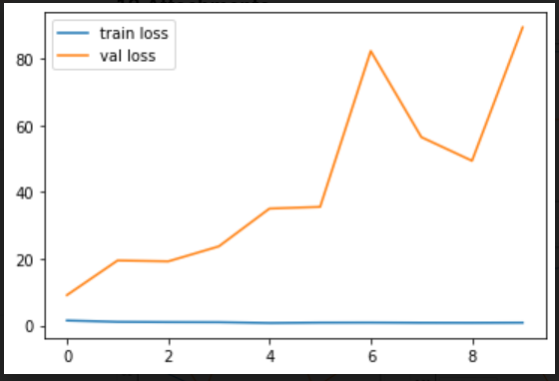
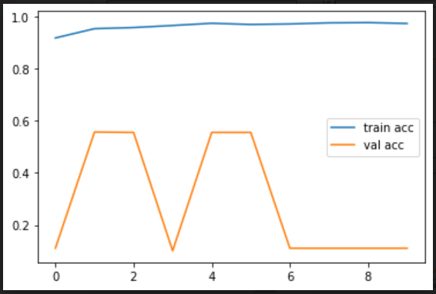
ResNet101 Accuracy and Loss

Slide 11
CONCLUSION
The study contributes to the possibility of a low-cost, rapid and automatic diagnosis of the disease. This proposed framework may be employed as a supplementary tool in screening COVID-19 patients in emergency medical support services.
we exhibited that deep learning with CNNs have considerable effects in the automatic detection of extraction of essential features from X-ray images that are related to diagnosis. Utilizing Transfer Learning and Computer Vision models generated high accuracy rates in Covid-19, Pneumonia and Normal cases detection.

Slide 12
FUTURE WORK
As a higher quality corpus of COVID-19 X-ray image data becomes available, it may be possible to produce models for faster diagnosis of COVID-19. Such a tool would be helpful in the areas where testing kits are unavailable.
A more in-depth analysis requires much more patient data, those suffering from COVID-19. For future approach, the focus could be on distinguishing patients indicating mild symptoms, rather than pneumonia symptoms.

Slide 13
REFERNCES
"https://en.wikipedia.org/wiki/Transfer_learning," [Online].
T. B. Ioannis D. Apostolopoulos, "Covid-19: Automatic detection from X-Ray images," Department of Medical Physics, School of Medicine, University of Patras, 26504 Patras, Greece, 2020.
J.-C. D. B.-P. D. Nardelli P, "Pulmonary Artery-Vein Classification in CT Images Using Deep Learning," IEEE Trans Med Imaging., vol. 37(11), no. doi:10.1109/TMI.2018.2833385, pp. 2428-2440, 2018.
A. Z. Karen Simonyan, "Very Deep Convolutional Networks for Large-Scale Image Recognition," Computer Science > Computer Vision and Pattern Recognition, vol. v6, 2015.
"Deep Residual Learning for Image Recognition," 2017. [Online].
T. K. a. T. K. Gandhi, "Automated Brain Image Classification Based on VGG-16 and Transfer Learning," International Conference on Information Technology (ICIT), Bhubaneswar, India, no. 10.1109/ICIT48102.2019.00023, pp. pp. 94-98, 2019

